Slide 2
Lesson Plan – Volume
Objectives and Habits of Mind To calculate the volume of a cube by counting multi link To calculate the volume of a cube using a formula. To calculate the volume of a cuboids using a formula. To calculate the volume of prisms and cylinders by first finding the area of the cross section . To discuss and compare approaches and results with others. To clearly communicate thoughts and ideas in a number of ways.
Keywords Cross Section, Dimension, Length, Width, Height, Prism
Mental and Oral Starter In groups pupils to discuss what volume means and then calculate the volume of the 3D shapes shown. Some groups may need to make the shapes using multi link cubes.
Main Activity Remind pupils of their roles. Each member of the group should select a 3D shape to work on and cut it out. They should then find the volume of each 3D shape by first working out the area of the cross section. Pupils should then glue the shape onto the group’s A3 paper and write down how they worked it out. The rest of your group must agree with your method.
Plenary Ask pupils to answer the probing question using mini white boards.

Slide 3
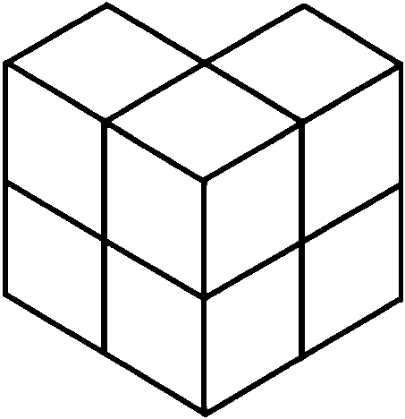
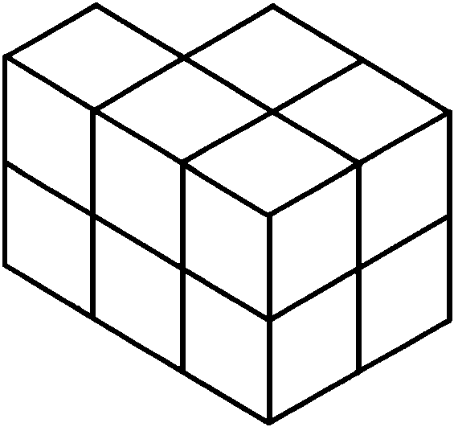
EQ How do I find the volume of 3D shapes
Key Words: Volume, Cross Section
In your groups discuss what the word Volume means and then calculate the volume of the 3D shapes below.

Slide 4
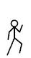
Level | 4 | 5 | 6 | 7 | 8
Shape Space Measure | I can calculate the volume of a cube by counting multi link | I can calculate the volume of a cube using a formula. | I can calculate the volume of cuboids using a formula. | I can calculate volumes and surface area of prisms and cylinders. | I can calculate the volume of cones and pyramids.
Today we are learning
I am starting the lesson on level _____________________
By the end of this lesson I want to be able to _____________________

Slide 5
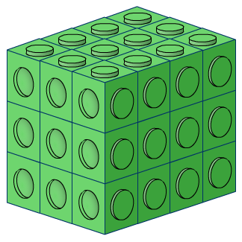
This is made out of multi-link cubes.
What is its volume?

Slide 6
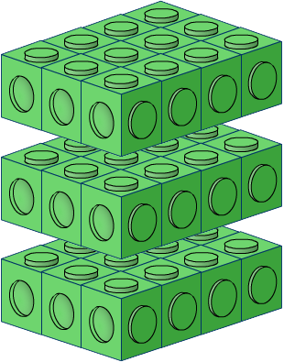
We can work this out by dividing the cuboid into layers.

Slide 7
4cm
2cm
8cm
How many cubes in a layer?
How many layers?
What is the volume? (How many cubes altogether?)

Slide 8
5cm
3cm
10cm
What is the area of a layer? (How many cubes in a layer?)
How many layers?
What is the volume? (How many cubes altogether?)

Slide 9
2cm
2cm
7cm
What is the area of a layer. (How many cubes in a layer?)
How many layers?
What is the volume? (How many cubes altogether?)

Slide 10
4cm
2cm
5cm
What is the area of a layer?
How many layers?
What is the volume? (How many cubes altogether?)

Slide 11
Height
Width
Length
How would you work out the volume?

Slide 12
Prisms
A prism is a 3-D shape that has a constant cross-section along its length.
For example, this hexagonal prism
has the same hexagonal cross-section throughout its length.
This is called a hexagonal prism because its cross-section is a hexagon.
Notes:
Tell pupils that cubes and cuboids are also examples of prisms. Prisms are usually named after the shape of their cross-section.

Slide 13
Volume of a prism
The volume of a prism is found by multiplying the area of its cross-section by its length or height.
l
h
A
A

Slide 14
Volume of a prism
What is the volume of this triangular prism?
7.2 cm
4 cm
5 cm
Area of cross-section = ½ × 5 × 4 =
10 cm²
Volume of prism = 10 × 7.2 =
72 cm³

Slide 15

Volume of a Cylinder
A cylinder is a special type of prism with a circular cross-section.
Volume = area of circular base × height
r
h
Notes:
Recall that the area of a circle is equal to πr².

Slide 16
Today’s Task
In your groups
Each member of the group should select a 3D shape to work on and cut it out.
Find the volume of each 3D shape by first working out the area of the cross section.
Glue the shape onto the group’s A3 paper and write down how you worked it out. The rest of your group must agree with your method.

Slide 17
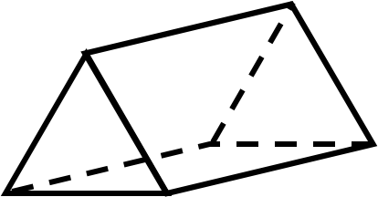
Cube
Cuboids
Find the volume of the 3D shapes.
5m
3
Triangular Prism
2m
7m
Cylinder
3cm
8cm
4cm
2m
10cm
12cm
6cm
Trapezium
12m
5m
12cm
8cm
4cm
3m
4.5m
2cm

Slide 18
Probing Question
If you know the height and volume of a prism what else do you know?
What don’t you know?

